Slide 1
HW9 補充資料
By 助教

Slide 2
Fibonacci Heap
https://www.itread01.com/p/290729.html
Compare with binary/ordinary heap：
Prim’s algorithm：V*EXTRACT-MIN + E*DECREASE-KEY
= O( V*lgV + E )
Procedure | Binary heap (worst case) | Fibonacci heap (amortized)
Build-Heap | O(1) | O(1)
INSERT | O(log n) | O(1)
MINIMUM | O(1) | O(1)
EXTRACT-MIN | O(log n) | O(log n)
UNION | O(n) | O(1)
DECREASE-KEY | O(log n) | O(1)
DELETE | O(log n) | O(log n)

Slide 3
van Emde Boas Tree
http://www.roading.org/algorithm/introductiontoalgorithm/Van_Emde_Boas_trees.html
Time complexity：
n = the largest weight of an edge in G
EXTRACT-MIN → O(lglgn)
DECREASE-KEY → O(lglgn)
Prim’s algorithm：V*EXTRACT-MIN + E*DECREASE-KEY
= O( (V+E)*(lglgn) )

Slide 4
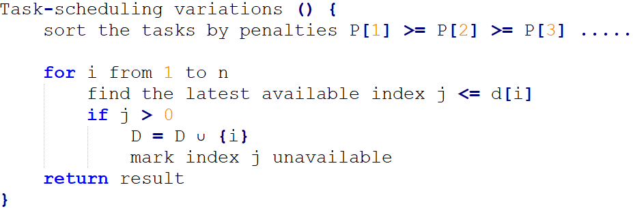
第六題 Task-scheduling variations
Pseudo-code：
O(n)
O(n) worst case

Slide 5
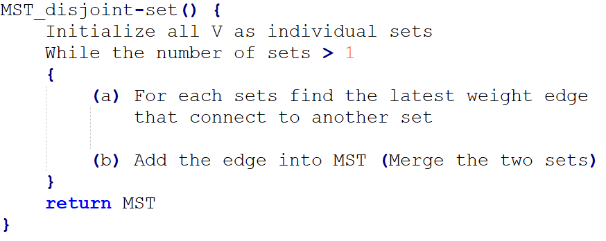
第七題 The third method of MST
Pseudo-code

Slide 6
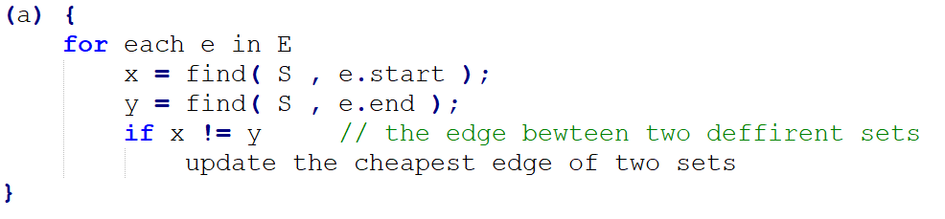
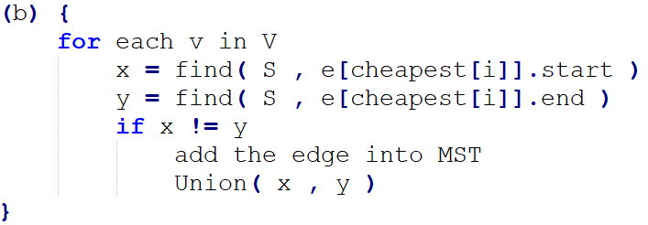
第七題 The third method of MST Conti.

